Slide 1

Database management system(CSE2004) COMMUNITY BOOK HOUSE CENTER
ADAVELLI ROHAN REDDY- 20BRS1270
NEERAJ J MANURKAR- 20BRS1269
DEVANSHU KHMEKA- 20BAI1319

Slide 2
ABSTRACT
A Community Book house Centre is a project that manages and stores books information electronically according to community members(users) needs. The system helps both users and the book house manager to keep a constant track of all the books available in the respective center. It allows both the admin and the user to search for the desired book.
This project has many features which are generally not available in normal Book House center like facility of user login, login as guest to donate the books. It has a facility of admin login through which the admin can monitor the whole system. It has a facility where user after logging in their accounts can see list of books issued and its issue date and return date. Alse we have different login portals for the community members and admin.

Slide 3
INTRODUCTION
In present day, most of the people don’t have a habit of reading books. Even if there are people who are interested, they don’t want to spend money to buy a book but rather rent.
So, we came up with the idea of a ‘Community Book House Center’ where a book house can be set up in large communities and they can borrow books to read in a hassle-free way.
We believe this will help people to reconnect with books and enjoy reading.

Slide 4
Since our platform will be 100% digital, there will be no physical waste, data errors or time delay which are often faced in the manual book management. Our project will also eliminate the issue of whether the desired book is there in the book house and if not present then it can be recommended in the feedback section.
This project is developed in php, MySQL, CSS, HTML,Bootstrap which mainly focuses on basic operations in a library like adding new books, and updating new information, searching books and users and return books.
For creating front-end we used CSS, Bootstrap and HTML. MySQL has been used for back-end and php is used to interact with backend

Slide 5
OBJECTIVES
Objectives of Community Book house Centre are-
To build a system where we can enter the record of new books and retrieve the details of books available in the library.
To build a system which can issue the books to the community members (users) and maintain their records.
To store properly the Book House items in order to maintain their security.
To enter and preserve details of the various issues and keep a track on their returns.
To manages the accounts of users which includes their name, id, borrowed items and etc.
To manages the fine if return date of book is exceeded.
To give people the chance to donate the books which they do not need by login in as guest.

Slide 6
EXIXTING SYSTEM
There are not many community book house centers currently in India.
Even in the existing ones all the transactions are done manually. Even if the database is maintained digitally the fines are calculated manually and also since there is no easily available record of the books present, the user would waste good amount of time in searching for the desired book.
Some of the existing systems doesn’t have proper details stored in the database such as the total number of users, interests of the users and etc.

Slide 7
LIMITATIONS OF EXISTING SYSTEM
Some of the limitations of existing system are-
Not proper retrieval of information.
Not all the entries are made in offline system.
Possibility of human made error is highly expected.
More space consuming for hard copies of data.
Manual calculation of fines
User records are not stored which can help in knowing their interested genre.

Slide 8
PROPOSED METHODOLOGY
Proposed system is an automated Community Book house Centre.
Every transaction, payment, details are present in the digital format, so there are little to no chances of errors.
Through our website user can add books, search books, renewal, update information, edit information, and return books in quick time.
Also, since the admin will have all the user history they can notice which genre is mostly liked and add more books from that category.

Slide 9
WHY DBMS FOR THIS PROJECT?
No need of manual record which take up large space when there are many users, like in a community.
The data can be more efficient and detailed
Possibility of human error is less and there is no possibility of duplication of data.
There will be more storage capacity.

Slide 10
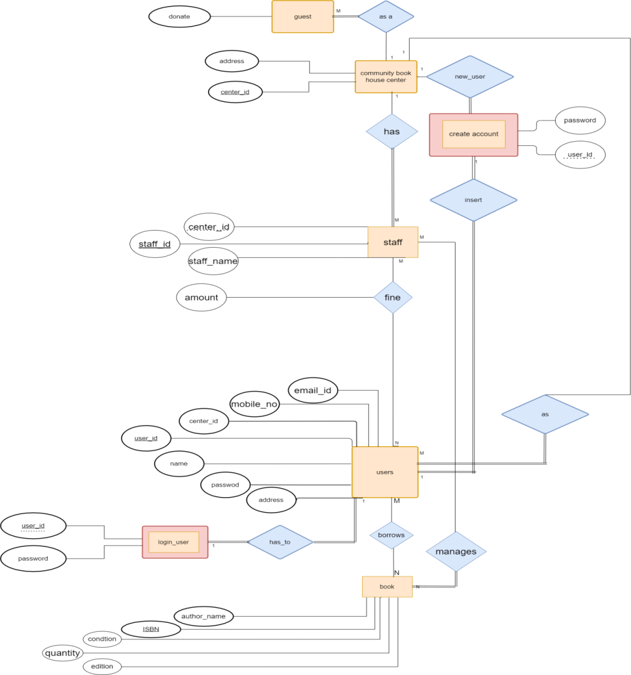
E-R DIAGRAM

Slide 11
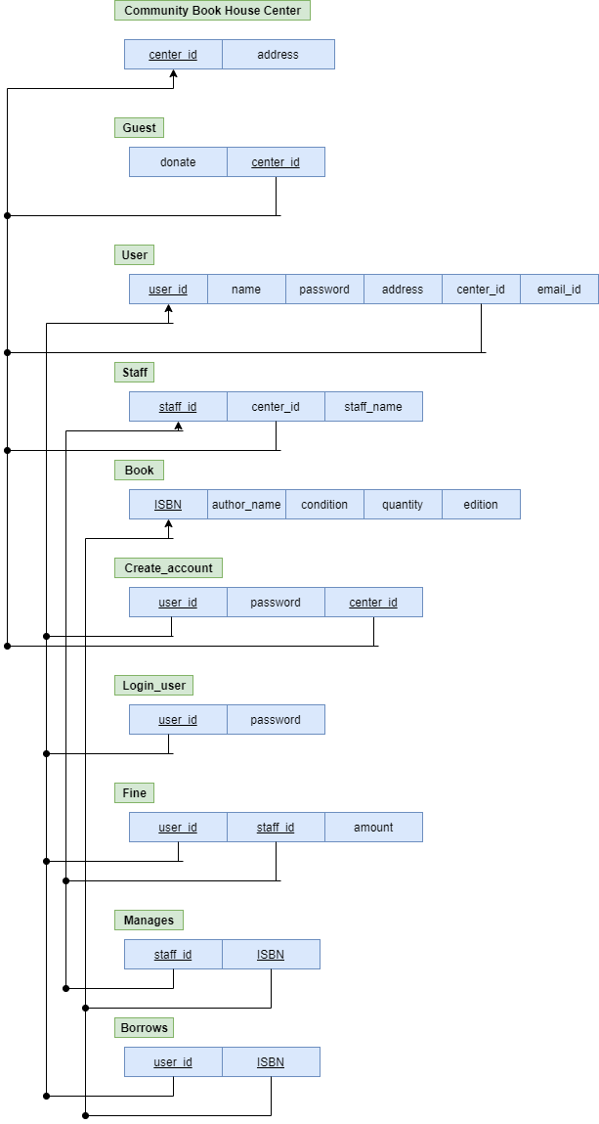
RELATIONAL SCHEMA

Slide 12
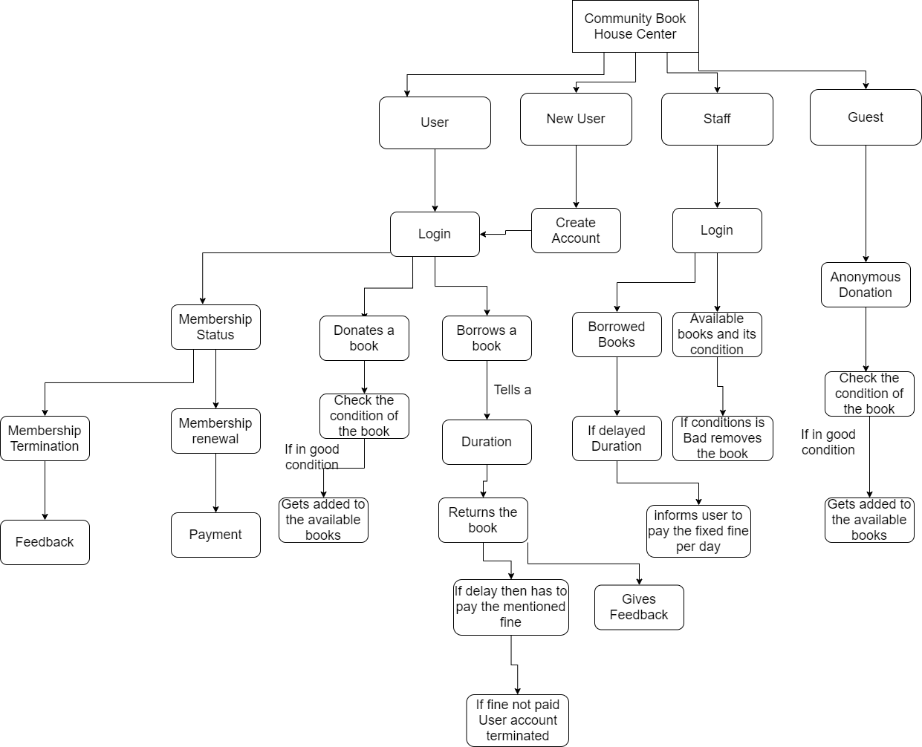
ARCHITECTURE DIAGRAM

Slide 13
• When the users enter the COMMUNITY BOOKHOUSE CENTER, they have to either sign up or login in to the community room website to avail the facilities of reading room.
• After they login the entries of their activities (like which book is read, time when user logged in and logged out) is stored in Book house database.
• The library staff has to assign the book only after that user will be able to borrow the book. This information also would be stored in the BOOKHOUSE CENTER database.
• So, the internal Level or schema is the part of the system architecture which is not visible to end users but the actual information of database is stored in it.
• External level or schema is the part visible to the users on their screen where they will have to first login and then enter their activities.
• Conceptual level is the connection between the internal and external levels.

Slide 14
MODULES
Module 1 – Registration
In this module, we are registering all the community members (users) in the system, they can register themselves through the sign-up option. Only the users who are registered can login and request for books.
Firstly, the users need to register themselves by going on the sign-up option and by filling all the required details they can easily register themselves and can request for the books they require.
If later the user feels to edit the profile, they can easily edit their information and also reset their password by going to profile > edit > submit.
Basically, we have two different registering portals, one is for the users and the other one is for the admin department. From the admin login one can see the activities of all the users.

Slide 15
Module 2 – Login and Logout
The default user of our Community Book house center is admin. Admin can see the community members information, add books, issue books and can also see the feedback given by other users.
A person can also login as guest if he/she just want to donate the book(s).

Slide 16
Module 3 – Books
In this module we are displaying information from the database regarding all the books that are available in the community book house center.
The community members can search books by the book name as well as from book the department. After finding out the book they can request for the particular book by book id, which is unique.
Now, the admin can see and issue the book from the admin side by going to the “Book Request” page.
Now, if the respective member has returned the book, then admin can update the information by going to “Expire List” and by giving the community member’s username, book id and then pressing the submit button.
Admin can add book and the following data will be updated in the database of the community book house center at the back-end

Slide 17
Module 4 – Fines
In this module we will display the fines of the community members who have not returned the book on time. The fine will be calculated till the time the book issued is returned back.
This section contains information such as the username, book id, date of return, days, fine in dollars, status.
Module 5 – Feedback form
In this module, we are taking the feedback from the users whether did they liked the book, its quality, the edition we can provide them. Also if the condition of the book was appropriate or not. If they were fine with the service we provided them or do they want some changes to be made.
In the feedback form a user can feel free to write down their respective comments so that the admin department can work accordingly.

Slide 18
Module 6 - Guest
A person can donate a book even without registering to our community book house center
This option is available in user index page
He/she can utilize feedback option to ask any query and this can also be done without registration

Slide 19
IMPLEMENTATION DETAILS
We have used the software phpMyAdmin for the implementation of the website COMMUNITY BOOK HOUSE CENTER.
All ‘behind the scene’ working of the connection of database and webpage was taken care of by XAMPP by just migrating the files.
We have used bootstrap to make the website look attractive.
We have used HTML language for describing the structure of web pages.

Slide 20
CSS has been used for the layout, font, colour( to make it attractive) of the webpage.
The admin can access and control the details of each user, the books they have borrowed, the books they have returned, pending dues, due date, feedback they have given etc.
We have used Visual Studio Code for text editing and sublime text editor for code editing.
These data are strictly inclusive for the admin and no other external person or user can access it

Slide 21
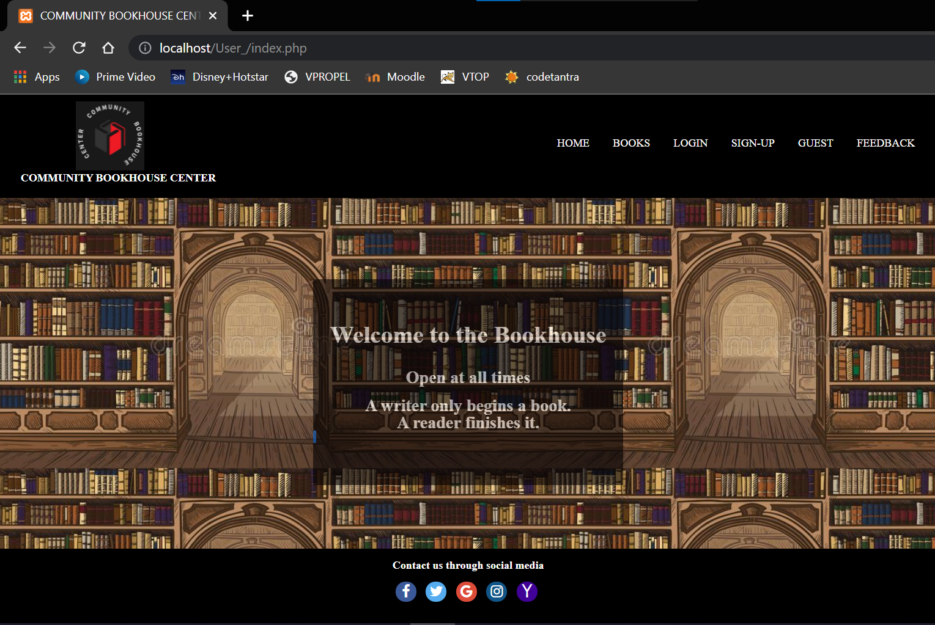
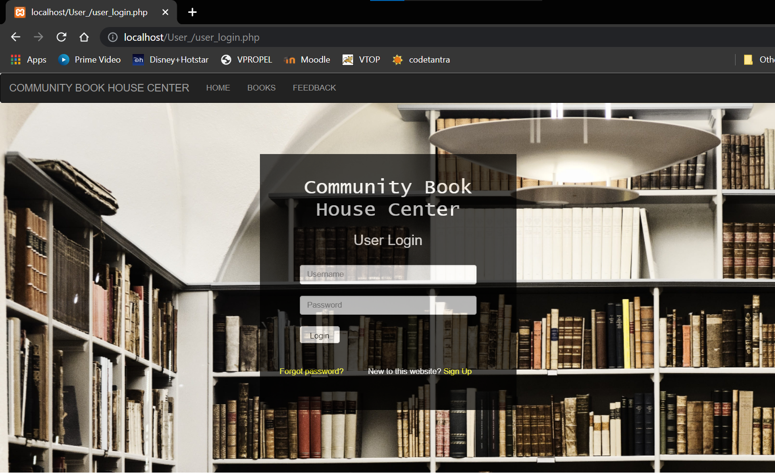
OUTPUT SCREENS
User Home Page
User Login

Slide 22
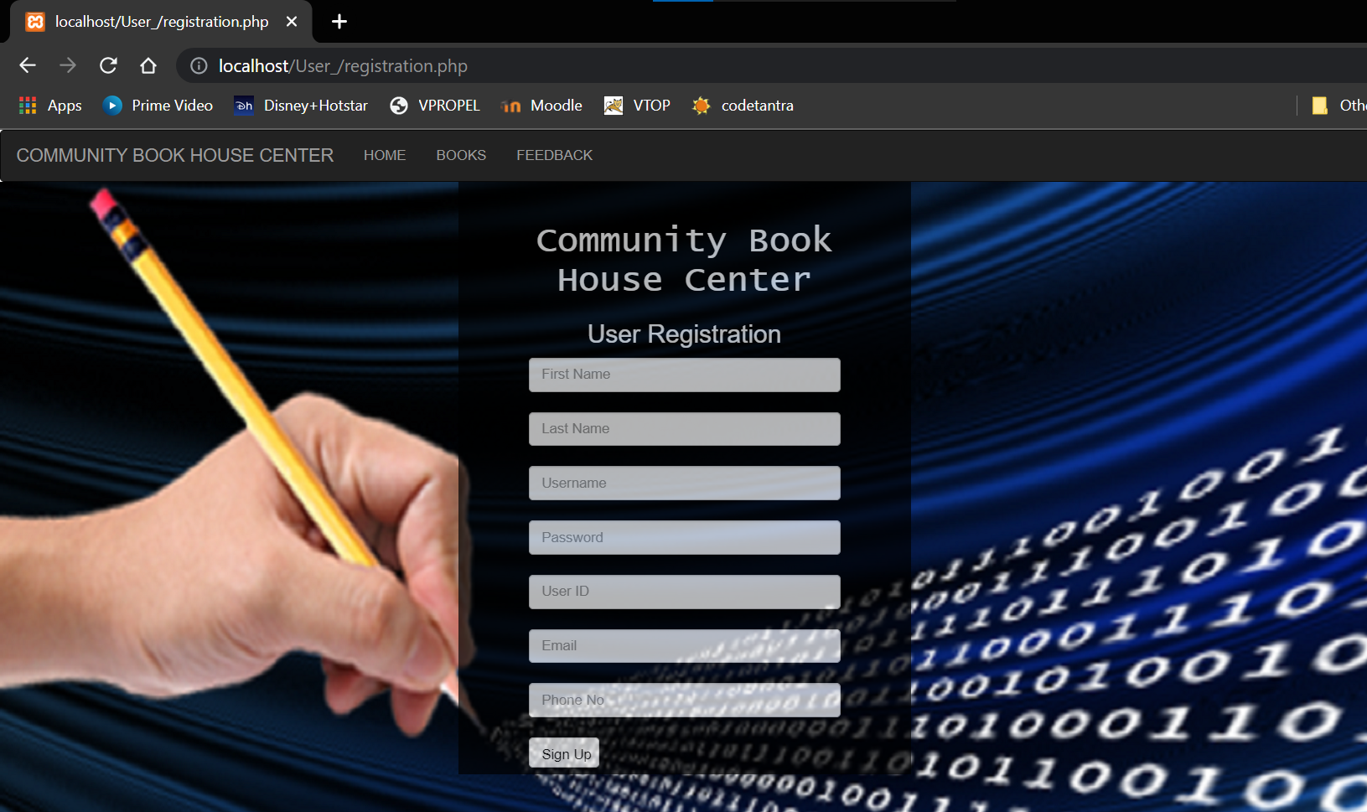
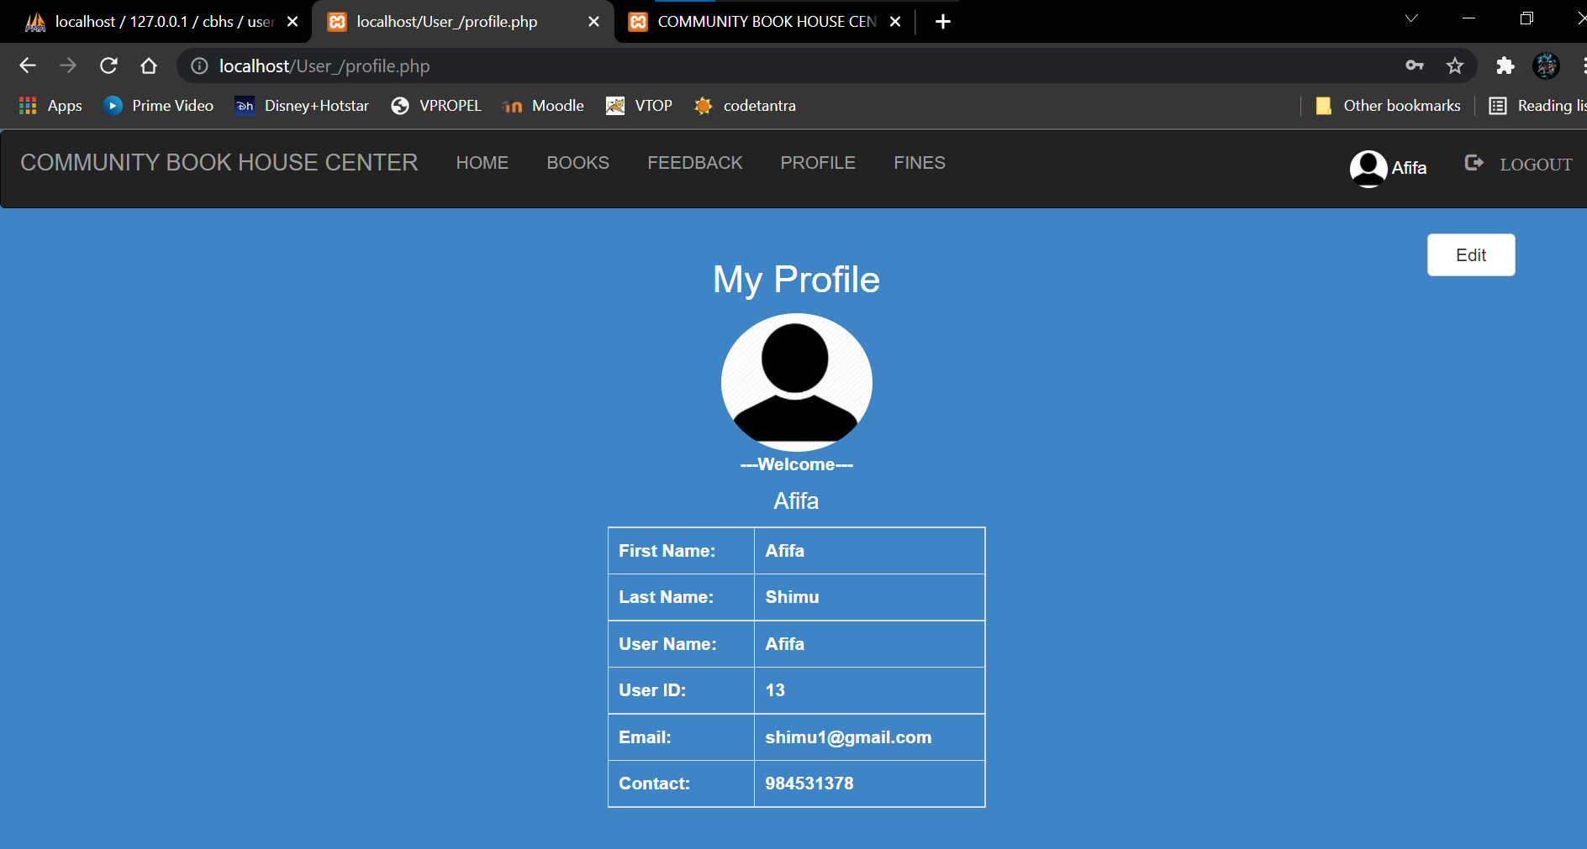
Registration
Profile

Slide 23
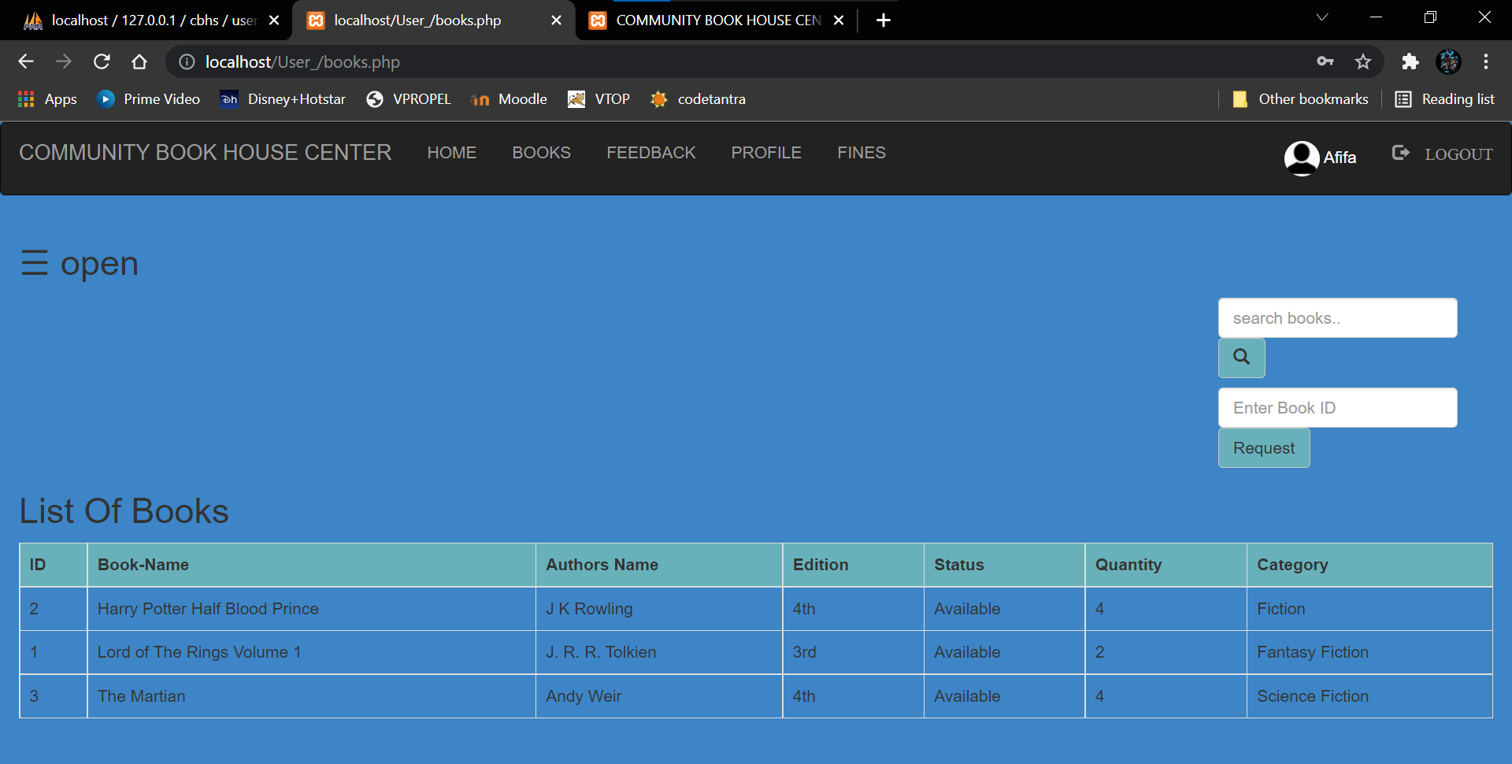
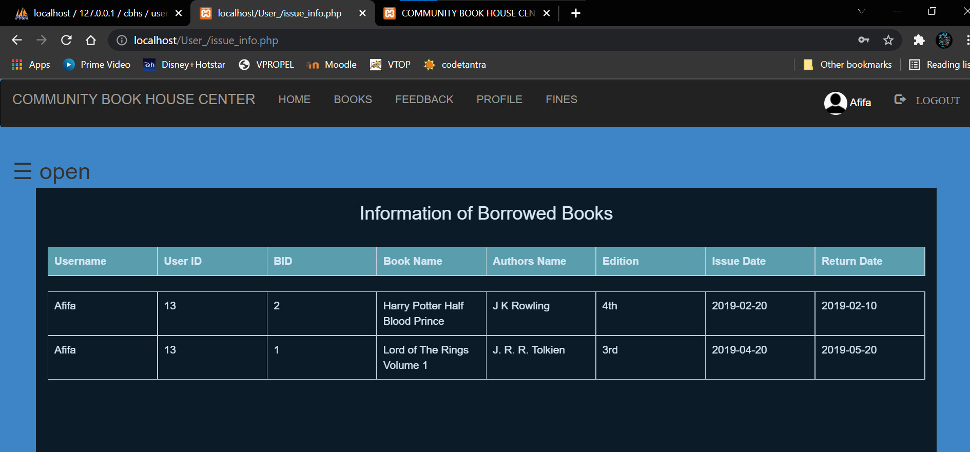
Book List
Issue Information

Slide 24
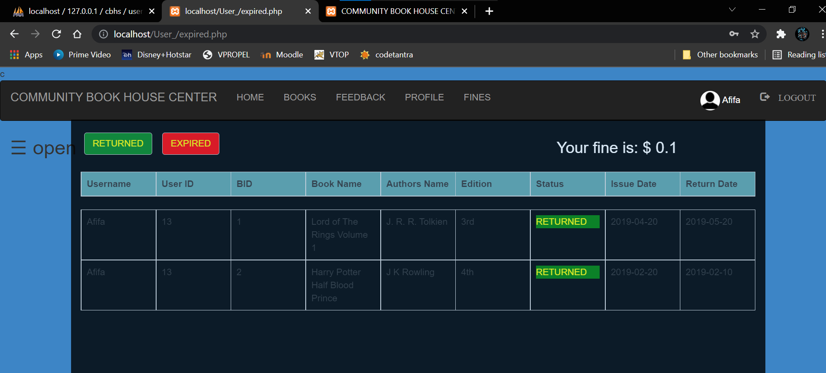
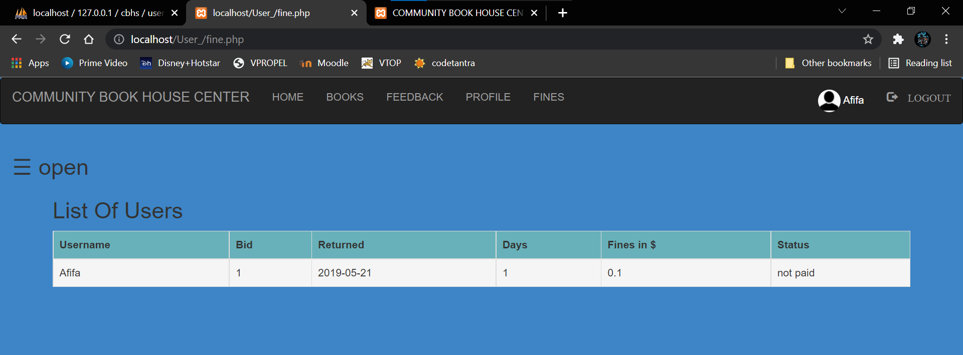
Expired List
Fines
Expired List

Slide 25
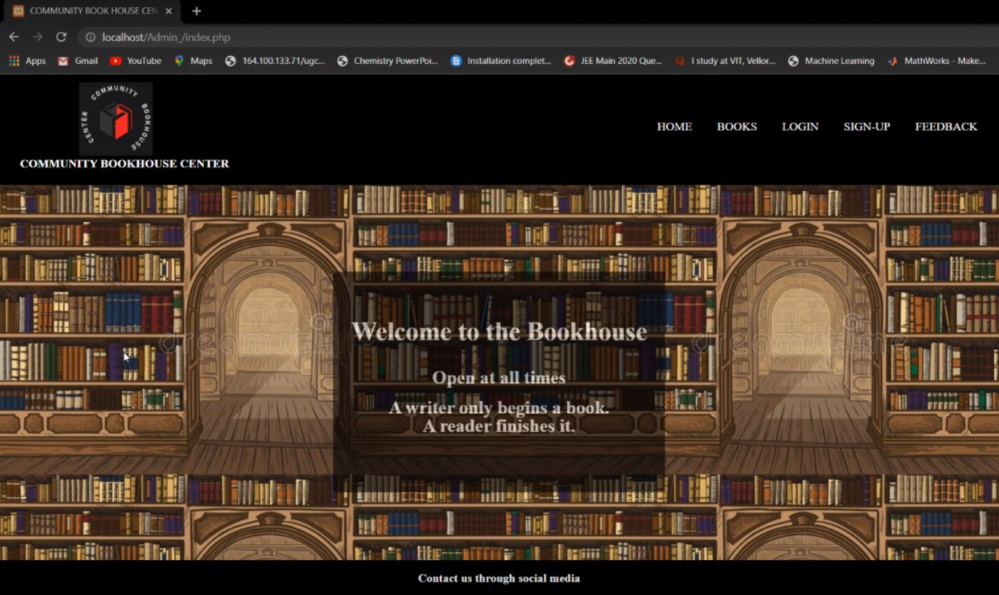
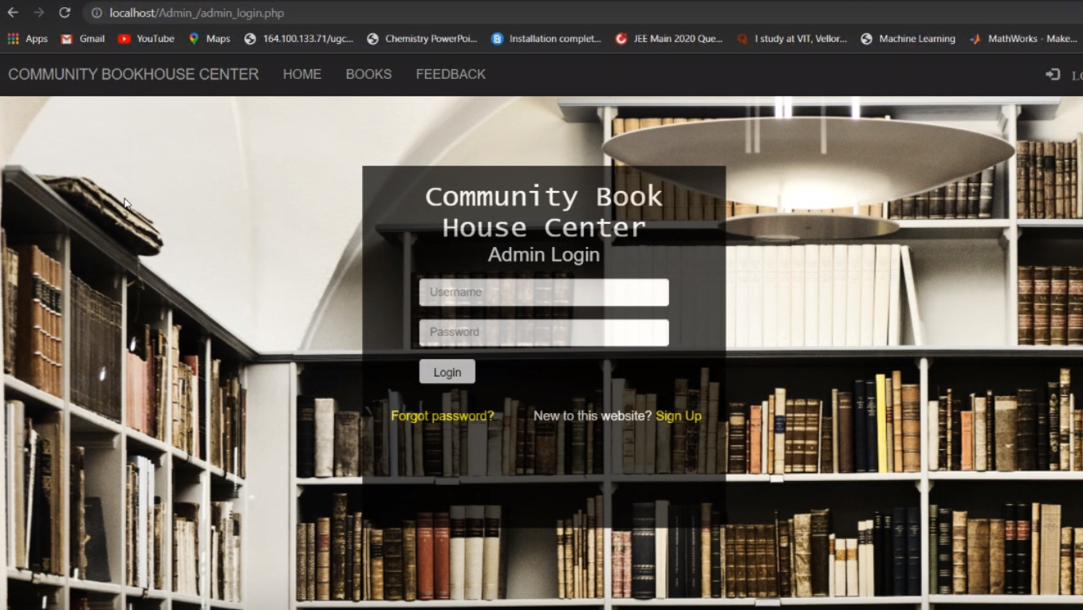
Admin Home
Admin Login

Slide 26
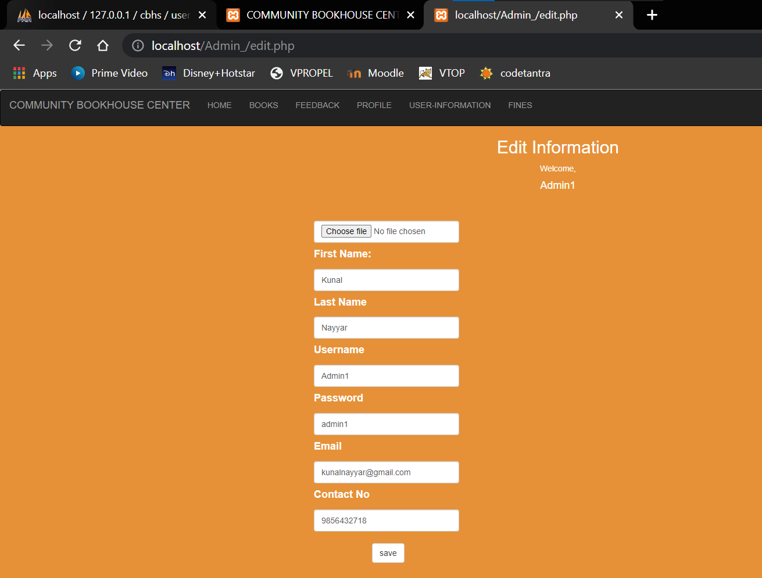
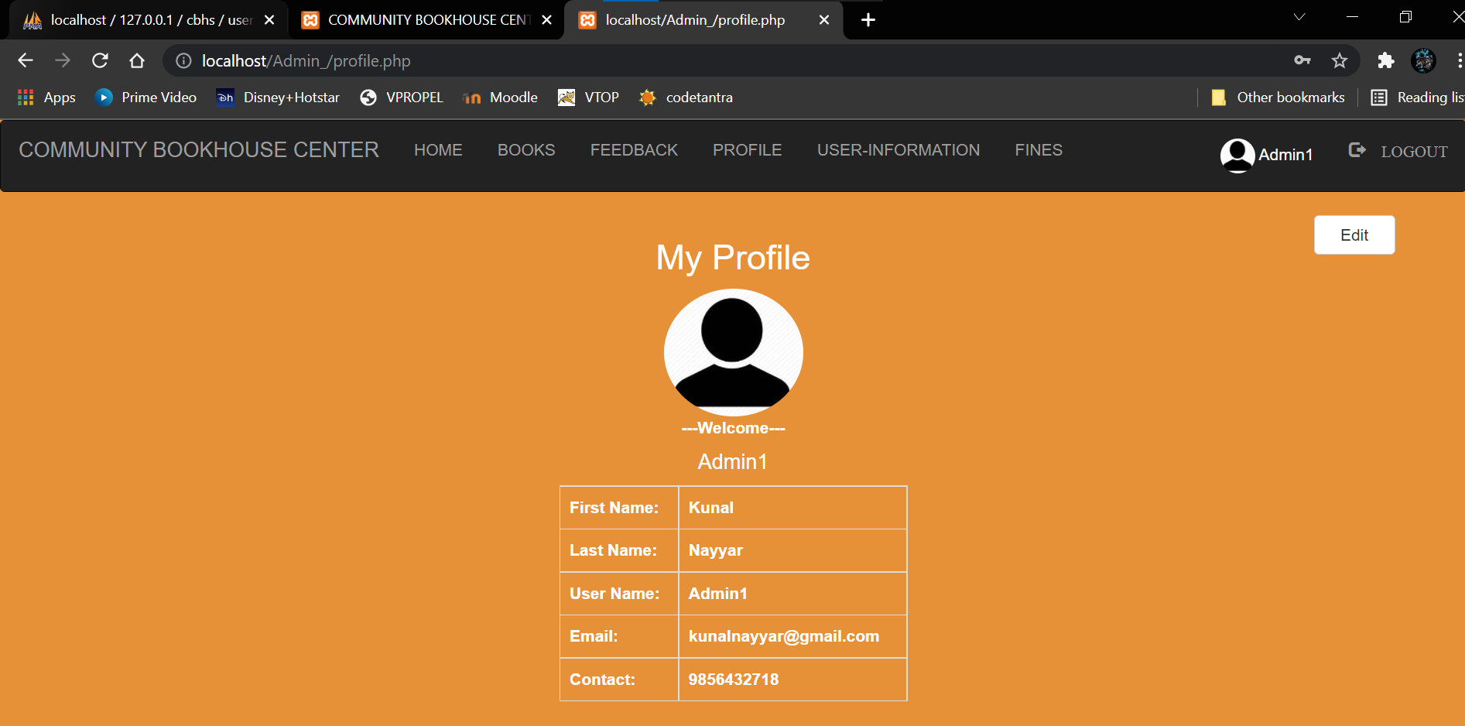
Profile Edit
Admin Profile
Admin Profile

Slide 27
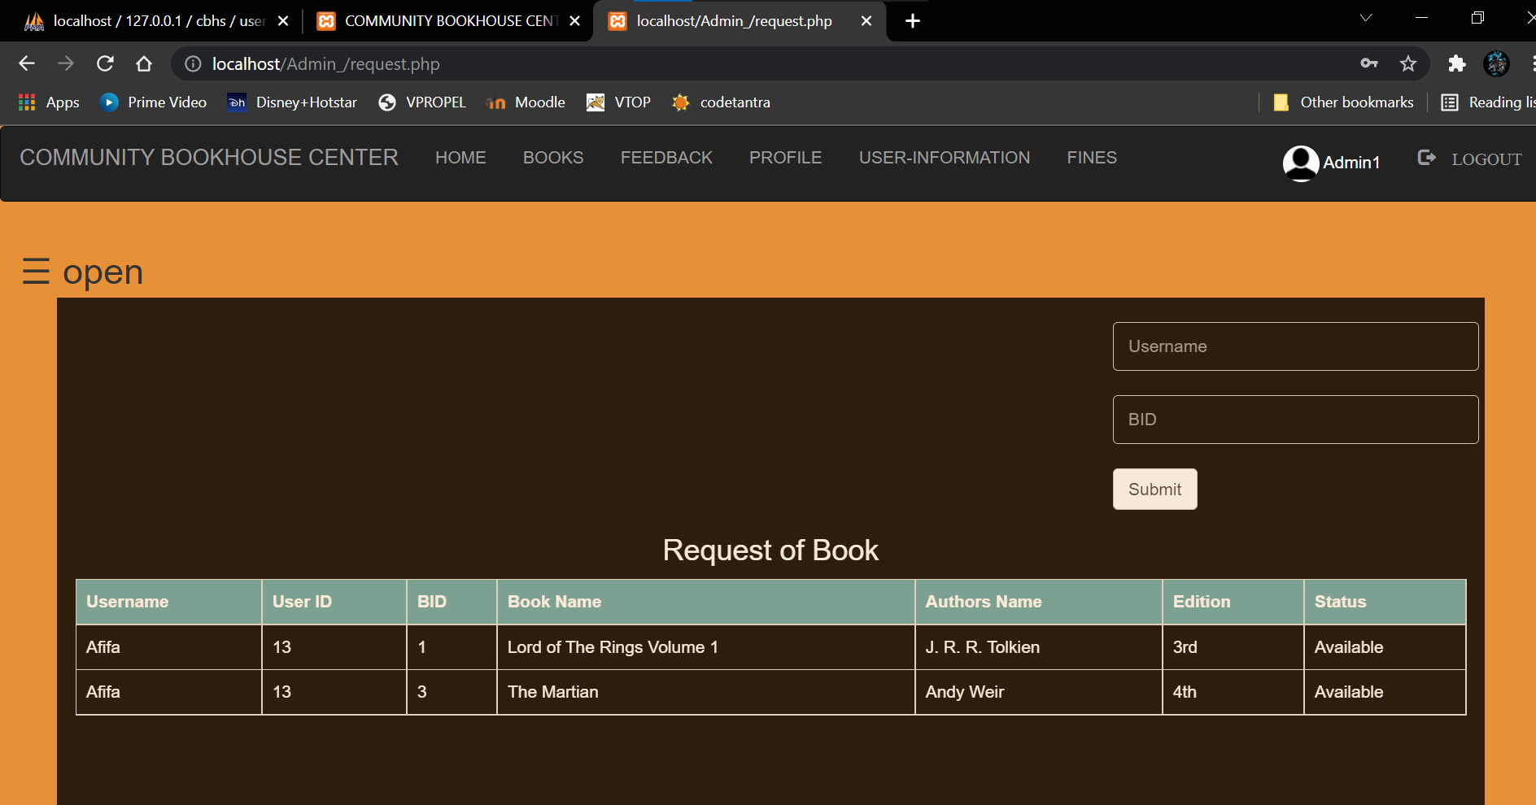
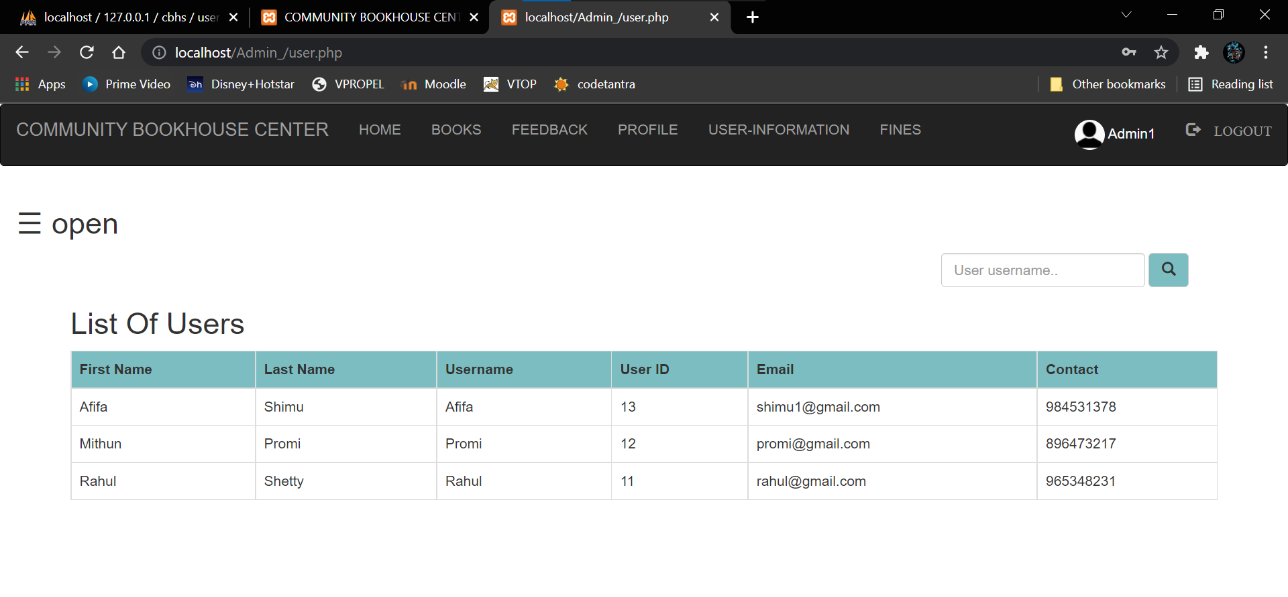
Book Requests
User Information

Slide 28
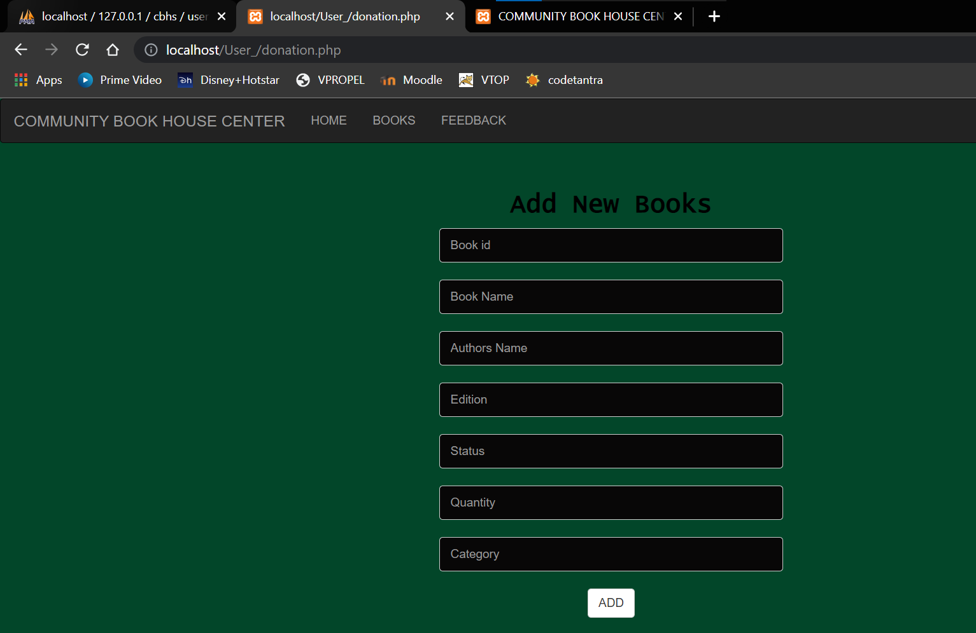
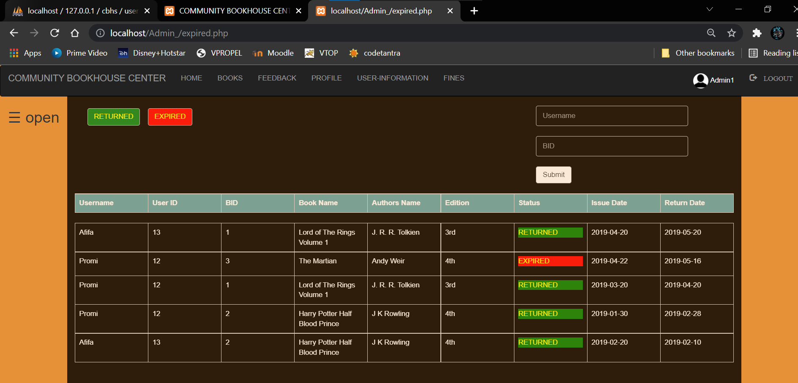
Guest Donation
Expired List (Admin Side)

Slide 29
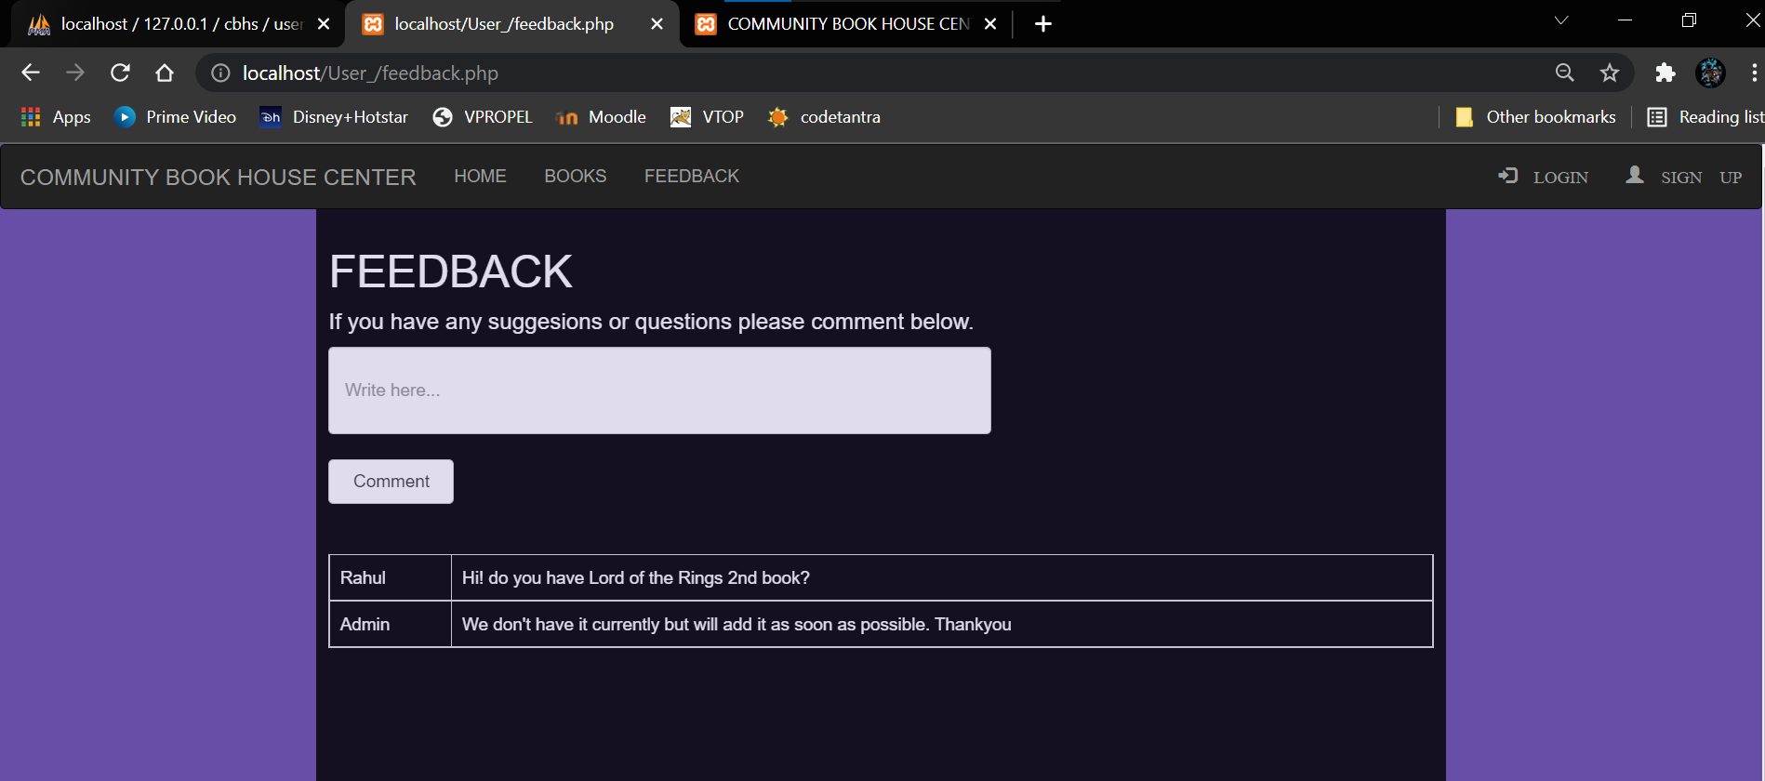
Feedback

Slide 30
CONCLUSION
This website provides a computerized version of Community Book house Center which will benefits the staff of the Book House Center.
It also provides an opportunity to the admin to maintain a user database and manage it accordingly, reducing the paper work.
It makes entire process online where admin/user can search books. Through this project, admin can digitally monitor the status of books.
It also helps in maintaining a systematic and structured database for newly issued, old as well as damaged books.
There is a future scope that we can expand our network to other communities if this is successful And maybe in the future, books can be shared between nearby communities also. In this way, we won’t be facing the issue of lack of books since if a book if a book is not there in one Book House, one can access it from other one.

Slide 31
REFERENCES
https://www.w3schools.com/
https://www.tutorialspoint.com/index.htm
https://www.javatpoint.com/
https://www.freecodecamp.org/news/

Slide 32
THANK YOU!

